Slide 1
Sentiment analysis of customer feedback and strategic recommendations
Presented by
Munem Shariar Shams
Date: 11.15.2025
Notes:
Good Afternoon everyone. My name is Munem Shariar Shams and today I’ll be presenting you with my analysis of the customer feedback data that the company provided me with and strategic recommendations based on the insights we get from the analysis of that data.

Slide 2
Project Overview
What We Did:
Analyzed customer comments and sales data
Conducted Sentiment Analysis on the customer feedback data
Evaluated 14 feature flavors across sales performance and customer satisfaction
Assessed operational performance across 8 parlor locations and 3 production facilities
Identified customer engagement patterns
Why we did it:
To understand what drives customer satisfaction
To identify our most successful products and operational strengths
To uncover opportunities for growth and improvement
To make data-driven decisions about product portfolio optimization
To leverage customer feedback for marketing
Notes:
Starting off with a brief overview of the project, What we did with this project is we analysed the customer comment and sales data to understand which products are doing well, which products are not doing so well. We also conducted sentiment analysis of the data, we assessed the operational performance of different parlor sites and production sites. So what all this does is that it gives us an understanding of what drives customer satisfaction. If we can identify which products are working well and which aren’t and we can identify our operational strengths then we can make more data- driven decisions and optimize our product portfolio. We can also leverage this data for marketing.

Slide 3
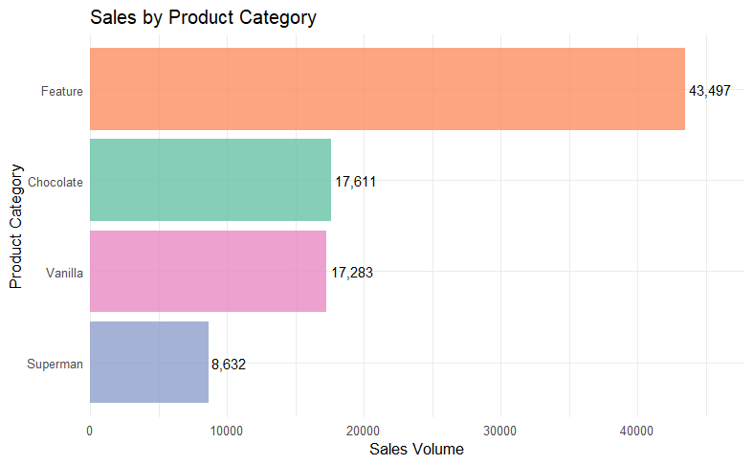
Analysis of Overall Sales
Key Insights from the Chart:
Feature Flavors: 43,497 units (50%)
Chocolate: 17,611 units (20%)
Vanilla: 17,283 units (20%)
Superman: 8,632 units (10%)
Recommendations:
We should focus on the feature flavors.
All ice cream companies produce basic flavors but these feature flavors are unique and only we produce them. So, we have to leverage this absence of competitors and use it as the driving force of our marketing campaigns.
Notes:
Firstly, when we analyzed the sales data we noticed that more than 50% of the total sales are comprised of the feature flavors. So these feature flavors which are unique and only we produce them in the market should be our strongest focus point. We should leverage the absence of any competitors and use this as a driving force in our marketing and our production.

Slide 4
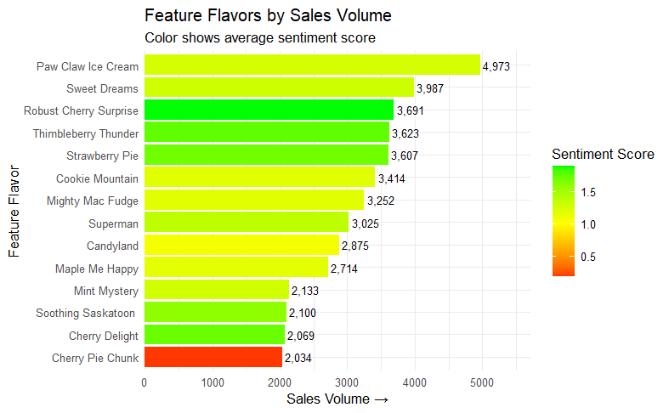
Analysis of Feature Flavors
Customer Favorites
The Robust Cherry Surprise has the highest sentiment score and the customers love it the most.
Thimbleberry Thunder is a strong niche favorite.
The Strawberry Pie is a consistent high performer.
Sales Champions
Paw Claw Ice Cream has sold the highest number of units.
The Sweet Dreams has a Strong market presence.
Immediate Concern
The Cherry Pie Chunk requires urgent attention since it is the only product with negative sentiment score.
Notes:
Moving on to our feature flavors, this chart shows us that all the flavors have great sentiment scores and the customers love them all. There is only one concern in this section which is the Cherry Pie Chunk flavor. It’s the only flavor with a negative sentiment score. I will talking about that in a quick minute.

Slide 5
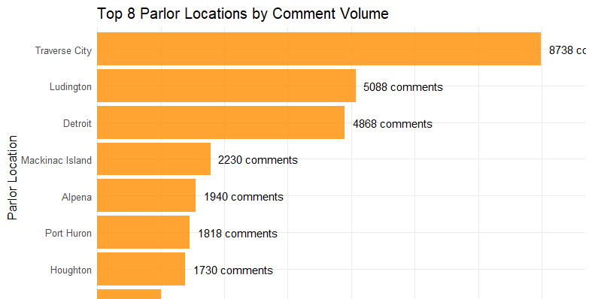
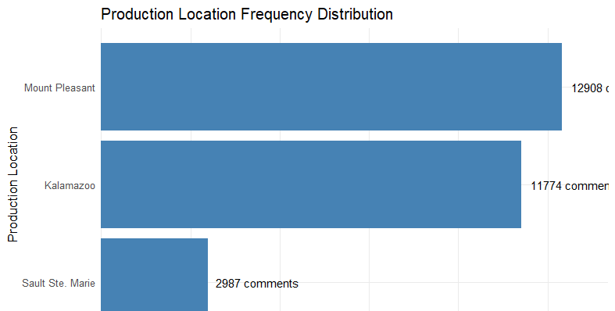
Top Performing Locations
Parlor Operations:
Traverse City: 8,738 comments with 1.53 sentiment score
Tourist location driving high engagement
Consistently excellent customer experiences
Production Facilities:
Mount Pleasant: 12,908 comments with 1.55 sentiment score
Highest volume and highest quality
Model for manufacturing excellence
Business Impact:
These locations represent our operational gold standard
Success factors should be replicated across all sites
Proven capability to handle volume while maintaining quality
Notes:
Let’s take a quick look at the production and parlor sites. Obviously, Traverse city being one of the most attractive tourist location in the state has the highest number of comments. Mount Pleasant is our production site which consistently showed us proven capability to handle the highest volume while maintaining the best quality as well.

Slide 6
Strategic Recommendations
Discontinue production of the Cherry pie chunk. Since it’s the only product with negative sentiment value, the best course of action would be to get rid of it.
Expand production and marketing of Robust Cherry Surprise, capitalize on the cherry flavor that customers like. So, get rid of the bad cherry flavor and double down on the good one.
Create combo packs with the top flavors. Based on my sentiment analysis we can create combo packs of the 3 top flavors that the customers love.
Use the positive customer feedback and comments for marketing in social media platforms. Use the quotes by the customers or feature them in marketing campaigns.
Notes:
Now to the important part, My concluding recommendations. As I mentioned before, the Cherry Pie chunk flavor should be discontinued. Since it is the only flavor that customers didn’t like I think the best course of action would be to get rid of it and instead focus our production and marketing on the Robust Cherry Surprise flavor. It’s another cherry flavor and it has the highest sentiment score among all the 14 feature flavors. So let’s just get rid of the bad one and double down on the good one. Since we now have insights based on the sentiment analysis and now we know what the customers love the most, we can create combo packs of 3 flavors. We can start this trend with one combo pack of the top 3 flavors and then we can move forward based on how it performs. Finally, my last recommendation would be to use all the positive customer feedback and the comments for marketing in social media platform. We have the data and we can use it for marketing.

Slide 7
Thank you
Notes:
That will be all for today but if anyone has any questions please feel free to reach out to me. Thank you!

